Slide 1
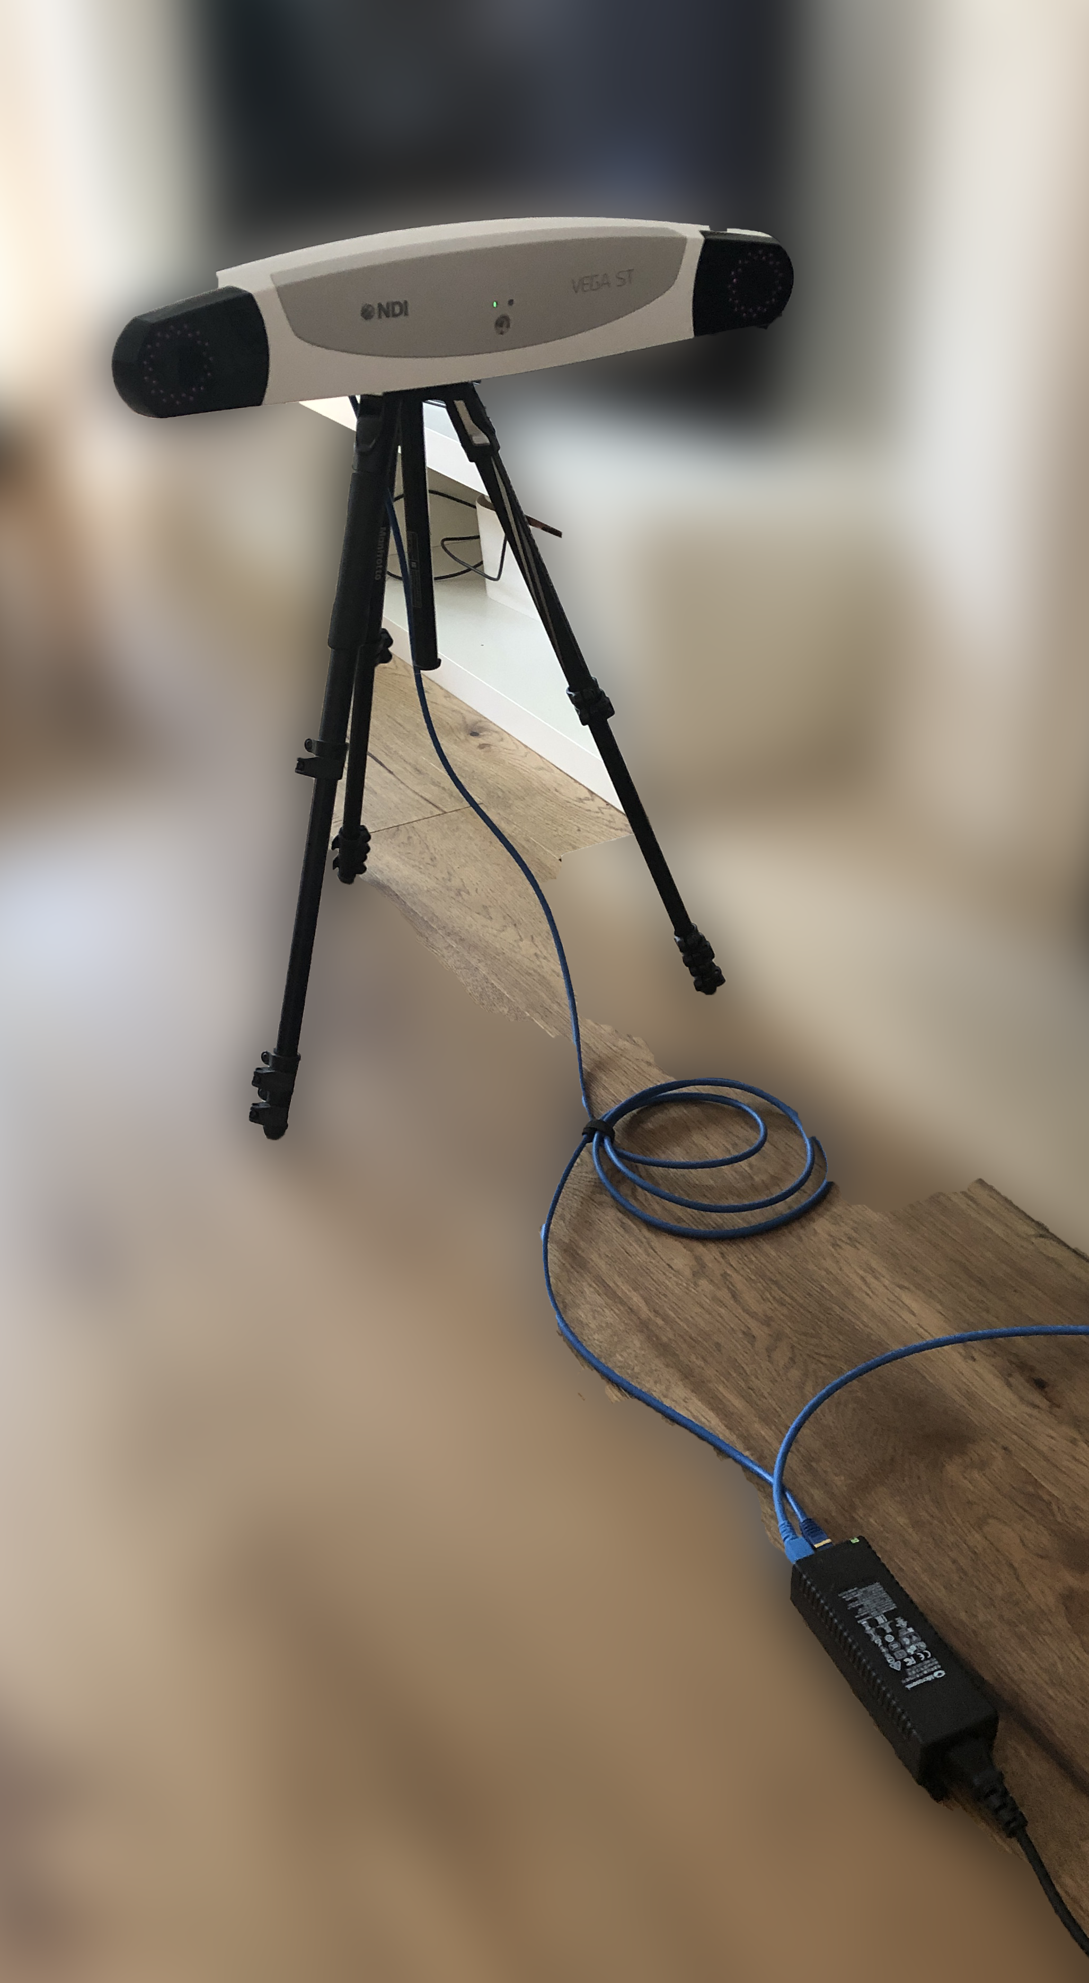
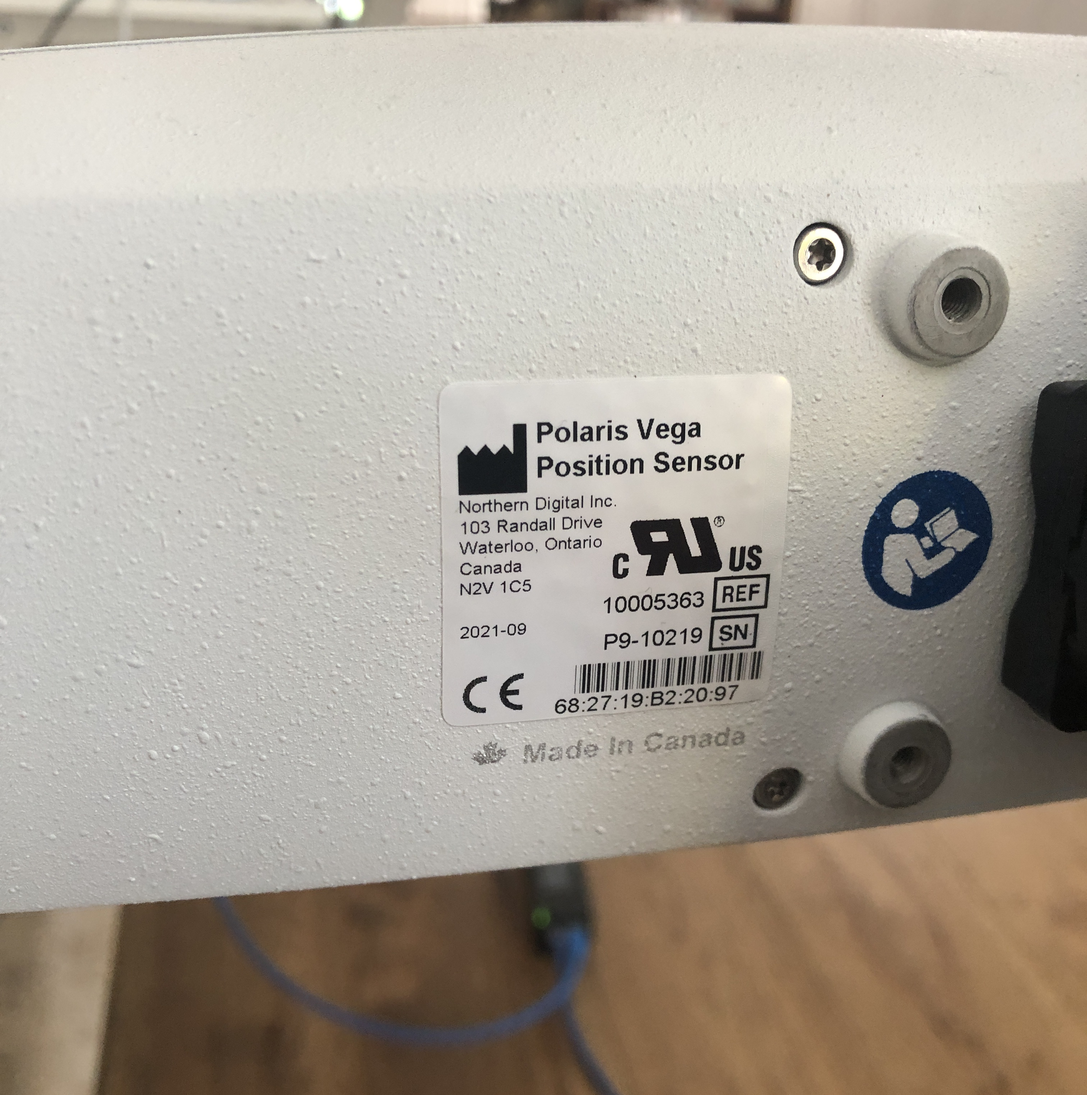
The device name shown at the back of the camera
To PC/laptop
To camera
power

